Slide 1
Introduction to Accounting and Financial Statements

Slide 2
Equity and debt capital

Slide 3
Raising Capital
Raising capital to launch or expand a business is a challenge.
Many entrepreneurs are caught in the “credit crunch.”
Chapter 13: Sources of Funds

Slide 4
Equity Capital
Represents the personal investment of the owner(s) in the business.
Is called risk capital because investors assume the risk of losing their money if the business fails.
Does not have to be repaid with interest like a loan does.
Means that an entrepreneur must give up some ownership in the company to outside investors.

Slide 5
Debt Capital
Must be repaid with interest.
Is carried as a liability on the company’s balance sheet.
Can be just as difficult to secure as equity financing, even though sources of debt financing are more numerous.
Can be expensive, especially for small companies, because of the risk/return tradeoff.

Slide 6
Accounting
Managers, investors, and other internal groups
want the answers to two important questions:
How well did
the organization
perform?
Where does
the organization
stand?

Slide 7
Financial Statement
A financial statement (or financial
report) is a formal record of the financial
activities of a business, person, or other entity.

Slide 8
Accountants answer these questions
with three major financial statements:
Income
statement
Balance
sheet
Statement of
cash flows

Slide 9
Basic Financial Statements
  Income statement – how much money you made last year?
    Revenue, expense, profits over a year or quarter.
  Balance sheet – What’s your current financial situation?
    Assets (value of what the firm owns),
    Liabilities (value of firm’s debts), and
    Equity (the money invested by the company owners)
  Cash flow statement – How did the cash come and go?
  cash received and cash spent by the firm over a period of time

Slide 10
Purpose of Financial Statements
Owners and managers require to make important business decisions .
Employees also for making collective bargaining with the management.
Prospective investors assess the viability of investing in a business.
Financial institutions decide whether to grant a company with fresh working capital or extend debt .
Government entities (tax authorities) need to ascertain the propriety and accuracy of taxes .
Media and the general public are also interested in financial statements for a variety of reasons.

Slide 11
Accounting Principles
To be useful, information should possess the following qualitative characteristics:
1 relevance
2 reliability
3 comparability
4 consistency

Slide 12
RELEVANCE
Accounting information has relevance if it makes a difference in a decision.
Relevant information helps users forecast future events (predictive value), or it confirms or corrects prior expectations (feedback value).
Information must be available to decision makers before it loses its capacity to influence their decisions (timeliness).
Notes:
6

Slide 13
RELIABILITY
Reliability of information means that the information is free of error and bias, in short, it can be depended on.
To be reliable, accounting information must be verifiable.
Notes:
7

Slide 14
COMPARABILITY
Comparability means that the information
should be comparable with accounting
information about other enterprises.
Notes:
8

Slide 15
Consistency
means that the same accounting principles
and methods should be used from year to
year within a company.

Slide 16
CHARACTERISTICS OF GOOD ACCOUNTING
Financial
Information has:
Relevance
Reliability
1 Predictive value
2 Feedback value
3 Timeliness
1 Verifiable
2 Faithful representation
3 Neutral
Comparability
Consistency
Notes:
9

Slide 17

The Process of Providing Information
STAKEHOLDERS
Internal:
Owners, managers, employees
External: Customers, creditors, government
1
Identify stake-holders.
Assess stakeholders’ informational needs.
2

Slide 18
The Process of Providing Information
Accounting Information System
Design the accounting information system to meet stakeholders’ needs.
Record economic data about business activities and events.
4
3

Slide 19
The Process of Providing Information
STAKEHOLDERS
Internal:
Owners, managers, employees
External: Customers, creditors, government
Prepare accounting reports for stakeholders.
5
Accounting Information System

Slide 20
An Income Statement
Sales
  Minus Cost of Goods Sold
= Gross Profit
Minus Operating Expenses
  Selling expenses
  General and Administrative expenses
  Depreciation
= Operating income (EBIT)
Minus Interest Expense
= Earnings before taxes (EBT)
Minus Income taxes
= Net income (EAT)
FIN3000, Liuren Wu

Slide 21
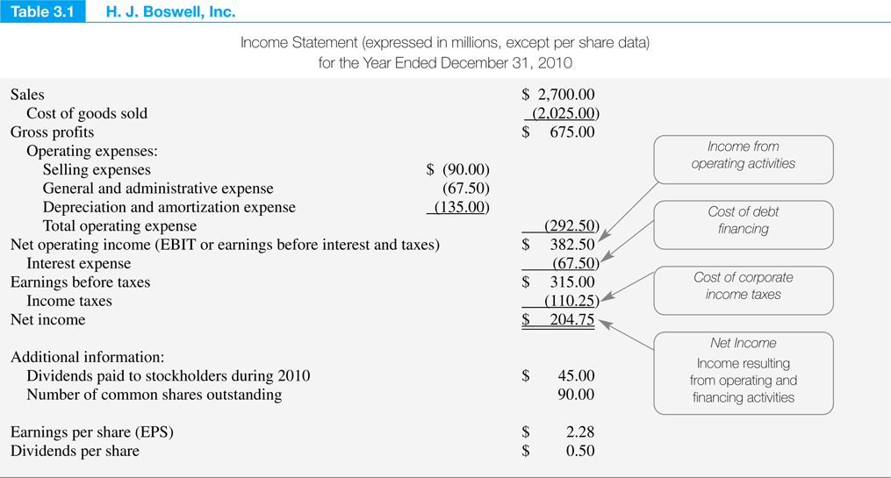
Sample Income Statement
FIN3000, Liuren Wu

Slide 22
Methods of
Financial Statement Analysis
Horizontal Analysis
Vertical Analysis

Slide 23
Horizontal Analysis
Using comparative financial
statements to calculate dollar
or percentage changes in a
financial statement item from
one period to the next

Slide 24
Vertical Analysis
For a single financial statement, each item
is expressed as a percentage of a significant total,
e.g., all income statement items are expressed as a percentage of sales

Slide 25
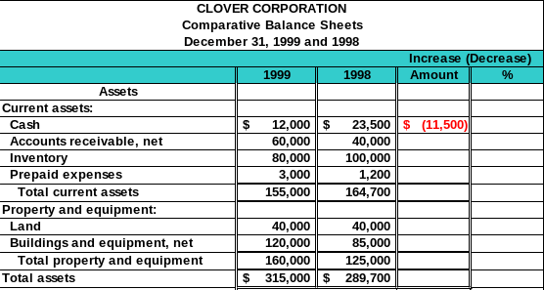

Horizontal Analysis Example
$12,000 – $23,500 = $(11,500)

Slide 26
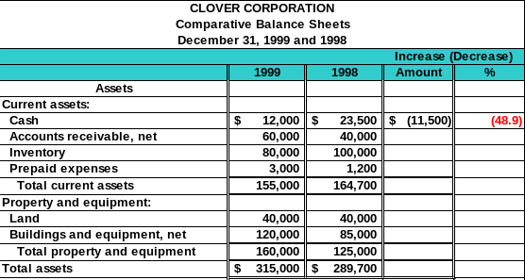
Horizontal Analysis Example
($11,500 ÷ $23,500) × 100% = 48.9%

Slide 27
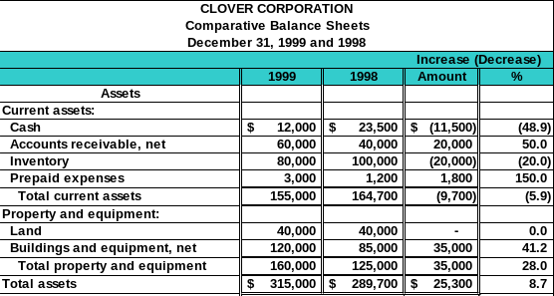
Horizontal Analysis Example

Slide 28
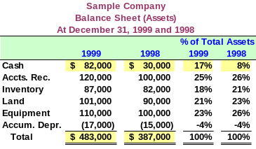
Vertical Analysis Example
$82,000 ÷ $483,000 = 17% rounded
$30,000 ÷ $387,000 = 8% rounded

Slide 29
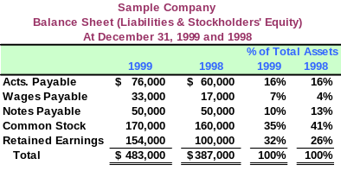
Vertical Analysis Example
$76,000 ÷ $483,000 = 16% rounded

Slide 30
Project Estimation

Slide 31
Definition of estimating
‘To form an approximate notion of the amount, number, magnitude or position of anything, without actual enumeration or measurement.’
Oxford English Dictionary

Slide 32
What estimates are made in projects
Time estimates are used in scheduling work, and determining delivery dates.
Cost estimates are used for budgeting.
Cost and benefit estimates are used in cost/benefit analysis to determine the overall viability of a project.

Slide 33
Importance of accurate estimates
Inaccurate time estimates can result in inefficient use of resources and late delivery.
Inaccurate cost estimates can result in insufficient budget being allocated, or excess budget being set aside for the project when it could be used for other projects.
If the cost or benefits estimates are inaccurate this can lead to incorrect decisions about proceeding with the project being made.

Slide 34
Estimating methods
Three commonly used methods of estimating are:
Top down estimating
Bottom up estimating
Parametric estimating

Slide 35
Top-down method
Identify a previous project or section of a previous project that is similar to the current project.
Assess the extent to which the current project is similar to the previous project – the comparison factor (e.g 1.5 if the current project is estimated to be 50% larger).
Compute the estimate for the current project based on the actual durations, effort or costs from the previous project and the comparison factor.

Slide 36
Bottom-up method
The method uses the Work Breakdown Structure (WBS) developed during the planning stage of the project. Estimates are created for all tasks at the lowest level of the WBS and then these are accumulated to determine the estimates for the whole project.
One disadvantage of the bottom-up method is that it is much more time-consuming than other methods.

Slide 37
Parametric method
The parametric method is also known as the object based method.
It is used to obtain definitive estimates and to confirm bottom up estimates where possible.
A simple concept is used, namely:
If the amount of effort needed to carry out a particular activity for a particular object is known, and the number of objects is known, the effort required to perform the activity for all the objects can be determined.
The amount of effort for the single activity can be determined either from a standard, which has been established from previous experience, or by executing a sample activity if no standard exists.

Slide 38
Parametric method (Cont.)
Steps in deriving the estimate:
Identify an item to be estimated.
Estimate the number of items.
Estimate the effort per item.
Multiply effort per item by number of items to determine the total effort.
For example, if the assembly of one library shelving stack takes an hour and a half and there are 40 stacks to assemble then the total effort is 60 hours.

